Slide 1


Directing Customers to Subscription Through App Behavior Analysis
Presented By
Kaushal Jeena
Vedant Choubey
Vijay Kumar

Slide 2
INTRODUCTION:
• The company wants to sell the premium version app with low advertisement cost. They gave the premium feature in the free app for 24 hours to collect customer behavior.
• They hired a Machine Learning Engineer to find customers interested in buying the product. Offers will only be given to those who are interested but cannot afford it.
• Our main aim to target the customer who are not willing to enrolled for the premium version of the application.
• This is classification-based problem.

Slide 3
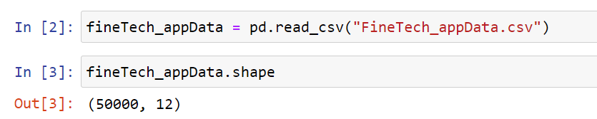
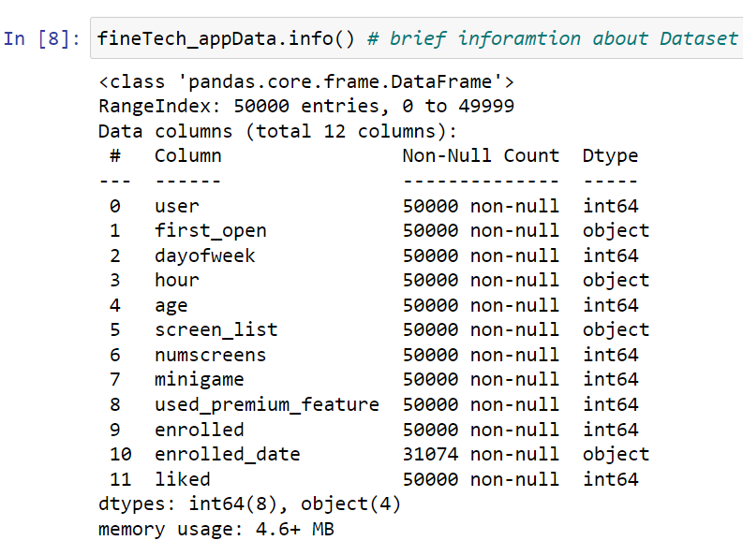
Dataset Used:

Slide 4
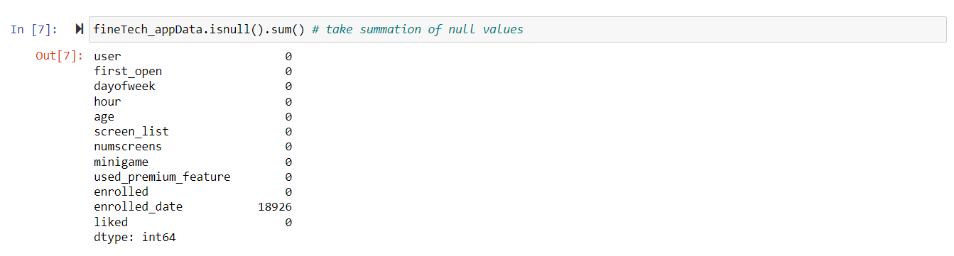
CHECKING FOR NULL VALUES:

Slide 5
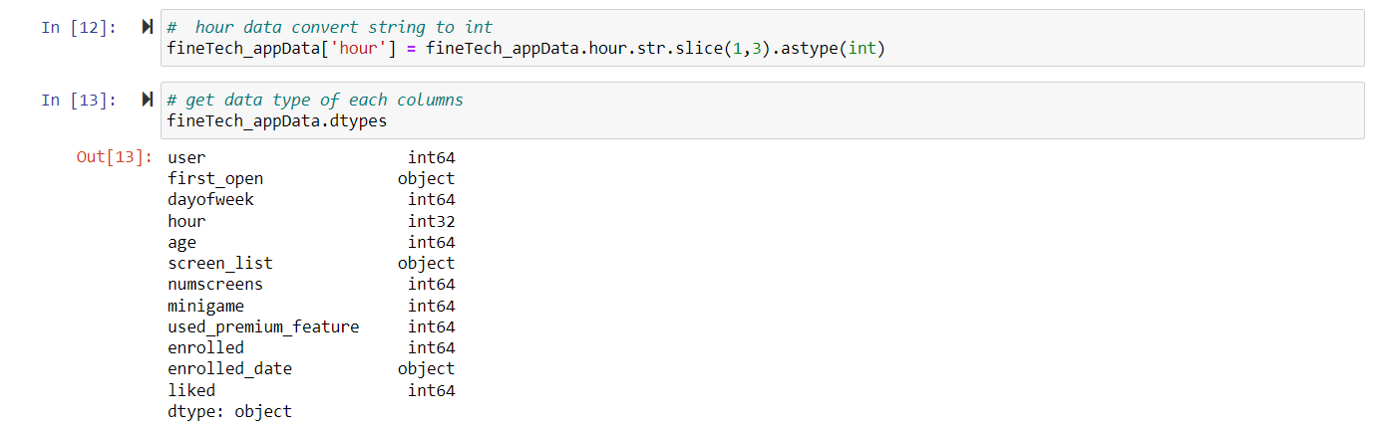
REVAMPING DATA TYPE

Slide 6
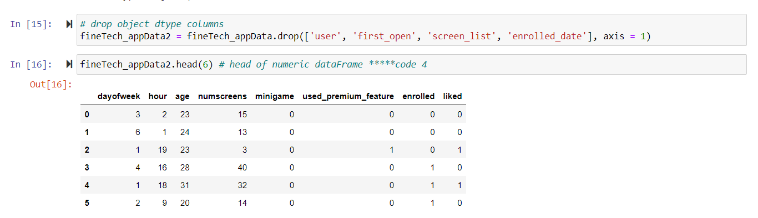
WIPING OUT CATEGORICAL DATA

Slide 7
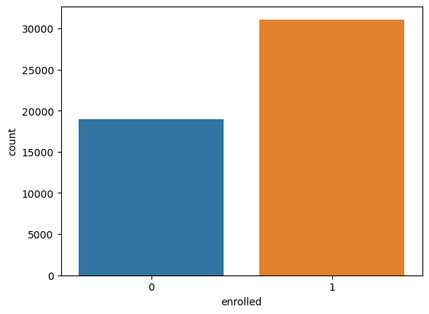

Data Visualization:
Countplot of enrollment of Customers:

Slide 8
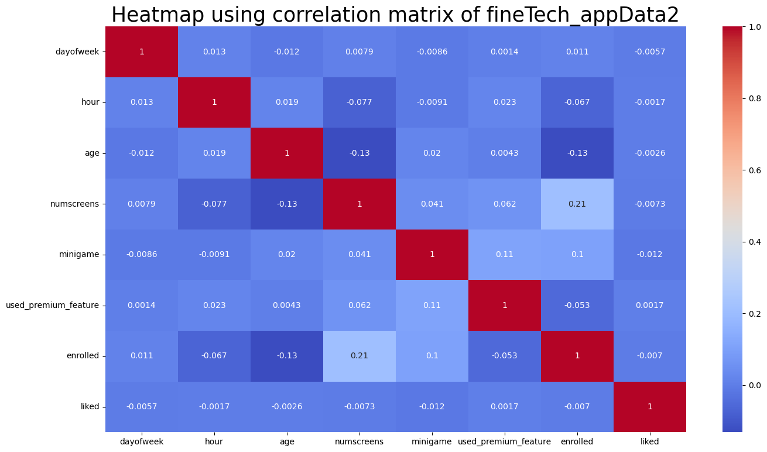
Heatmap uses to find the correlation between each and every features using the correlation matrix.

Slide 9
Interpretation of Above Correlation Matrix:
The fineTech_appData2 dataset does not exhibit strong correlations between its features.
A weak correlation exists between the number of screens viewed by customers and their enrollment in the premium app.
There is a slight correlation between a customer's engagement in the mini-game and their enrollment or use of premium features.
Conversely, there is a slightly negative correlation between a customer's age and their enrollment in the premium app or the number of screens they viewed.
This suggests that older customers are less likely to use the premium app and view multiple screens.

Slide 10
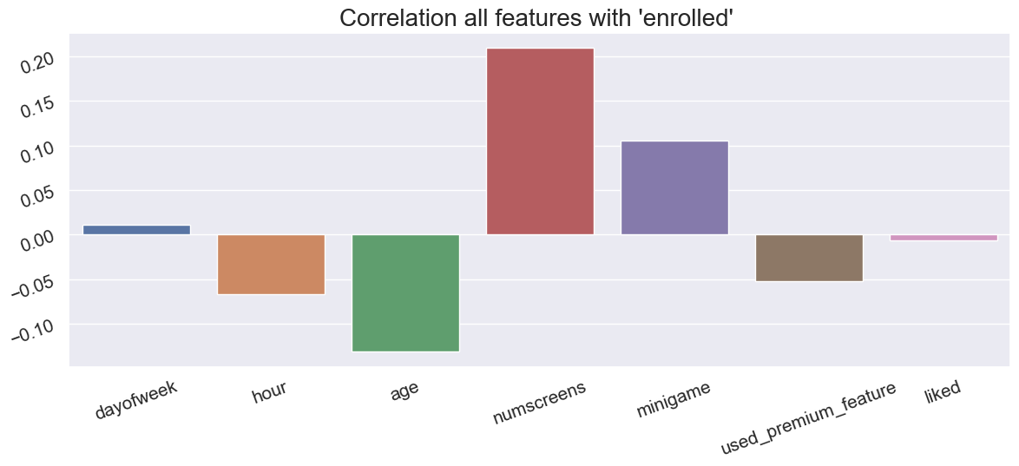
Correlation barplot with 'enrolled' feature:

Slide 11
Observations:
dayofweek is least positively correlated & says that if you join the app in day 0(sunday) then their is most likely to get enrolled to the premium features
Hour is negatively correlated with target variable shows the earlier the hour(in night) the most likely to get enrolled
age is also negatively correlated reflects that the younger users are most likely to get enrolled
Numscreen is positively correlated with target shows that more the no. of screen user visits more chances of getting enrolled
minigame also shows that more the minigame user play more chances of getting enrolled
liked is very least negative which does not have much impact in target
interestingly used_premium_feature is negatively correlated with response meaning that if user used the premium feature in 1st 24 hour that he/she might not enroll after the trial version of premium features

Slide 12
Machine learning algorithms used :
The target variable is categorical type 0 and 1, so we have to use supervised classification algorithms.
To build the best model, we have to train and test the dataset with multiple Machine Learning algorithms then we can find the best ML model.
We have data imbalancing in our data so we decide to use tree based classification algorithms
SVM(support vector machine)
Random forest
XG Boost
KN-Nearest

Slide 13
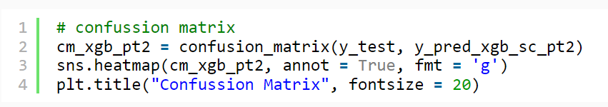
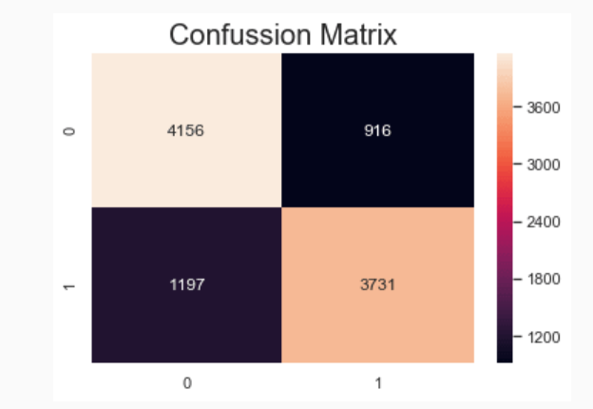
CONCLUSION:
To get more accuracy, we train all supervised classification algorithms but you can try out a few of them which are always popular. After training all algorithms, we found that SVC and XGBoost classifiers have given high accuracy than remaining but we have chosen XGBoost.

Slide 14
THANK YOU

